Slide 1
Digital Portfolio
STUDENT NAME: Kavitha N
REGISTER NO AND NMID: autunm1455bca2313683396/340231
DEPARTMENT: Bca
COLLEGE: Tagore college of arts and science Madras University

Slide 2
PROJECT TITLE
Personal Portfolio Website – Kavitha N

Slide 3


AGENDA
Problem Statement
Project Overview
End Users
Tools and Technologies
Portfolio design and Layout
Features and Functionality
Results and Screenshots
Conclusion
Github Link
3/21/2024 Annual Review

Slide 4

PROBLEM STATEMENT
In today’s competitive digital world, having a personal portfolio is essential for showcasing skills, creativity, and professional identity. Many developers and designers struggle to present their work effectively, which reduces visibility to potential recruiters, clients, and collaborators. Hence, the challenge is to design a personal website that reflects individuality while ensuring simplicity, clarity, and professionalism.

Slide 5

PROJECT OVERVIEW
This project is a personal portfolio website created for Kavitha N, a passionate developer who focuses on crafting tranquil and intentional digital experiences. The portfolio highlights her skills, design philosophy, and contact details, serving as a professional platform for networking and career opportunities

Slide 6

WHO ARE THE END USERS?
Recruiters looking to evaluate skills and design style Clients seeking digital solutions and creative services Peers and collaborators in the tech/design community General audience interested in learning more about the developer

Slide 7

TOOLS AND TECHNIQUES
Frontend: HTML, CSS, JavaScript Frameworks/Libraries: Bootstrap (or similar for responsive design) Version Control: Git, GitHub Pages for hosting Design Tools: Figma/Canva for layout inspiration (if used)

Slide 8
POTFOLIO DESIGN AND LAYOUT
Minimalist & Elegant UI with calm colors and intentional spacing Navigation Sections: Home, About, Contact Typography: Clean fonts with emphasis on clarity Responsive Design: Mobile-friendly layout Imagery: Personal photograph and subtle visuals
8

Slide 9
FEATURES AND FUNCTIONALITY
About Section: Personal introduction and design philosophy Contact Section: Interactive form to collect queries (Email, Phone, Subject, Message) Navigation Menu: Simple and accessible menu bar Responsive Layout: Works seamlessly across devices Live GitHub Hosting: Deployed for easy accessibility

Slide 10

RESULTS AND SCREENSHOTS
Home Page: "Designing serene digital journeys with intentional touches" intro
About Page: Developer’s background and philosophy
Contact Page: Address, email, phone details with contact form
Screenshots: (Attach the ones you shared from your mobile, showing each section
3/21/2024 Annual Review
10

Slide 11
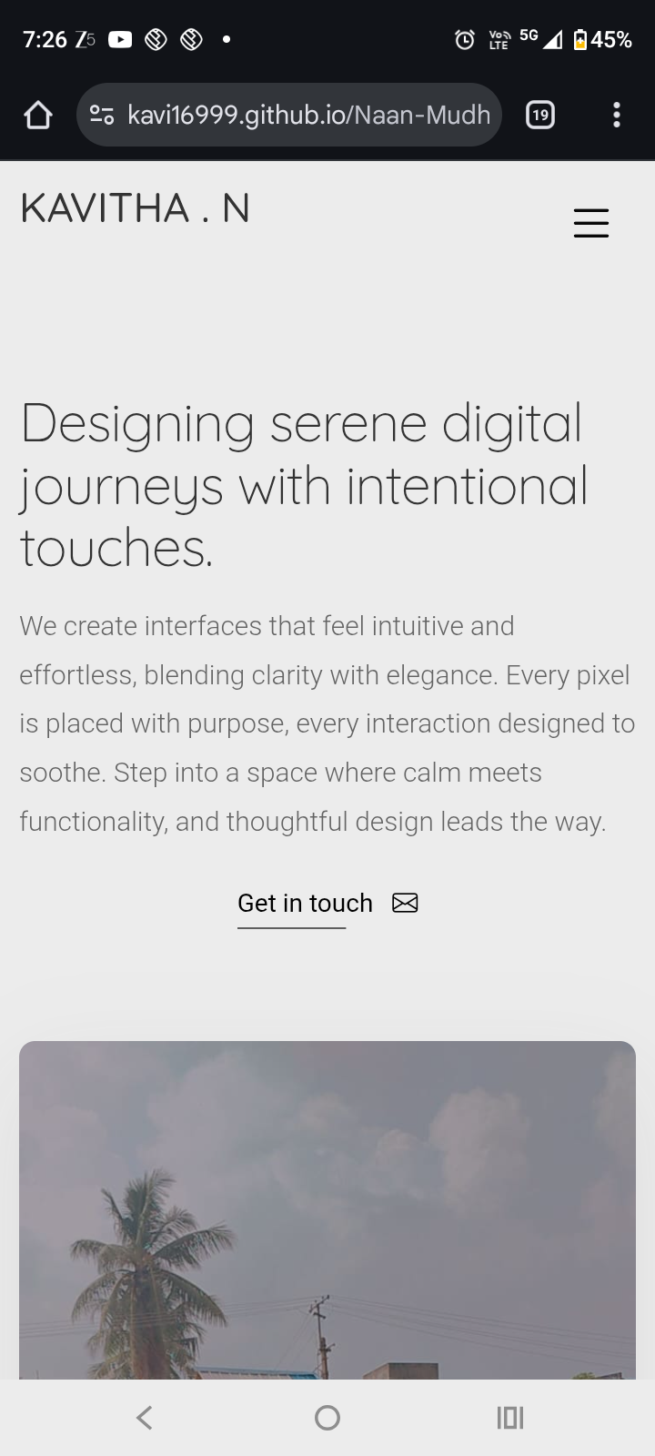
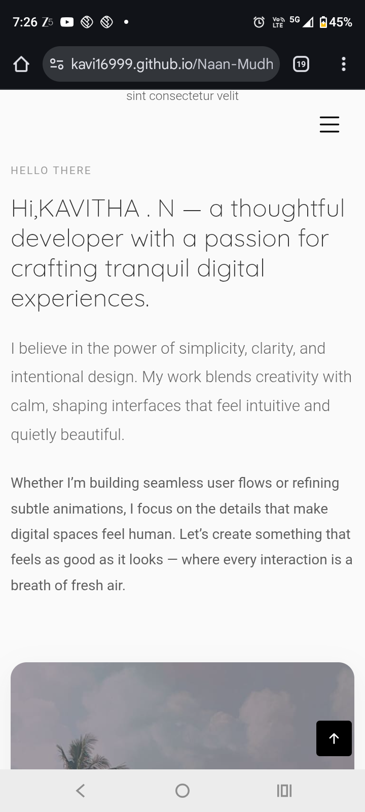
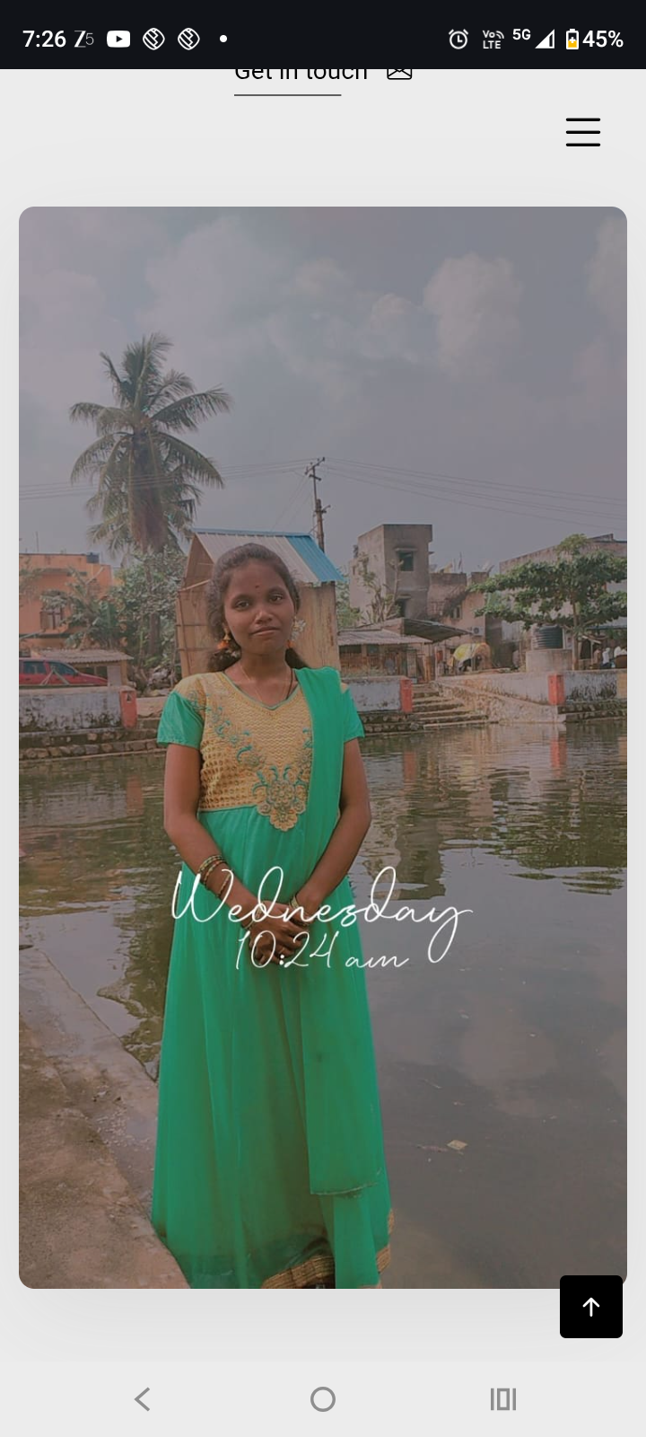

Slide 12
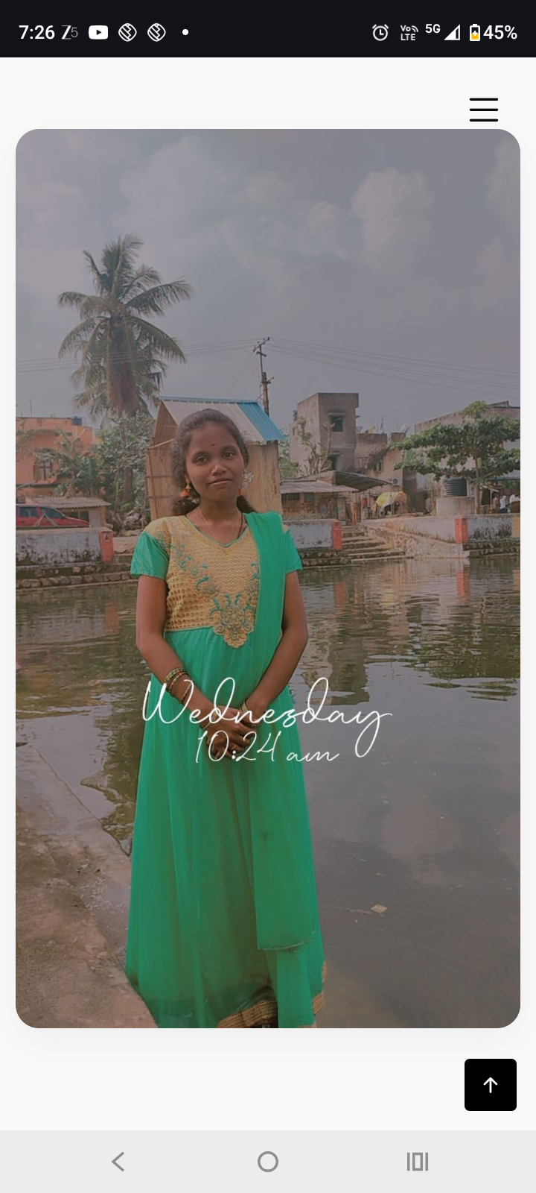
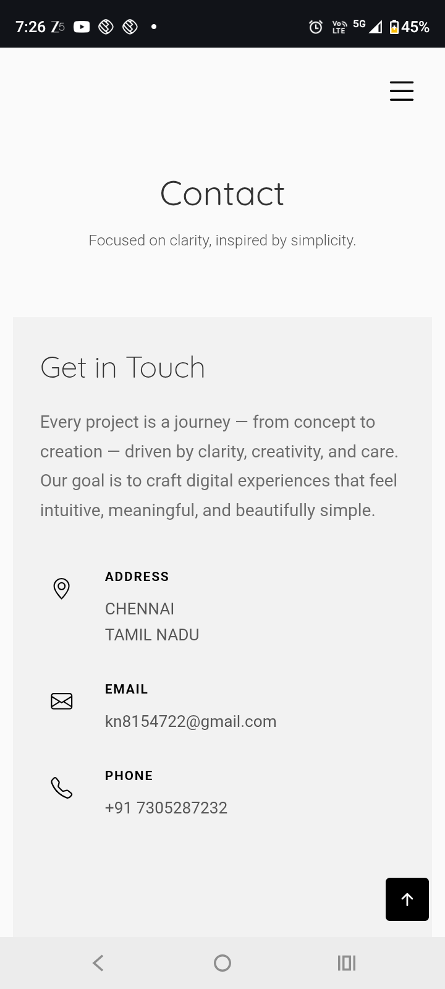
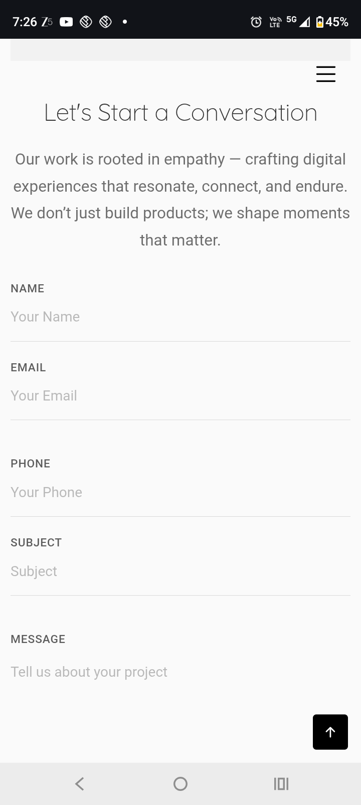

Slide 13
Conclusion
The personal portfolio website successfully showcases Kavitha N’s skills, creativity, and professionalism in an elegant and simple way. It not only acts as a professional digital identity but also provides recruiters and clients with an easy way to connect. Future improvements could include integrating a blog section, project showcases, or animations to further enhance engagement.

Slide 14
https://kavi16999.github.io/Naan-Mudhalvan-Portfolio /

